Slide 1
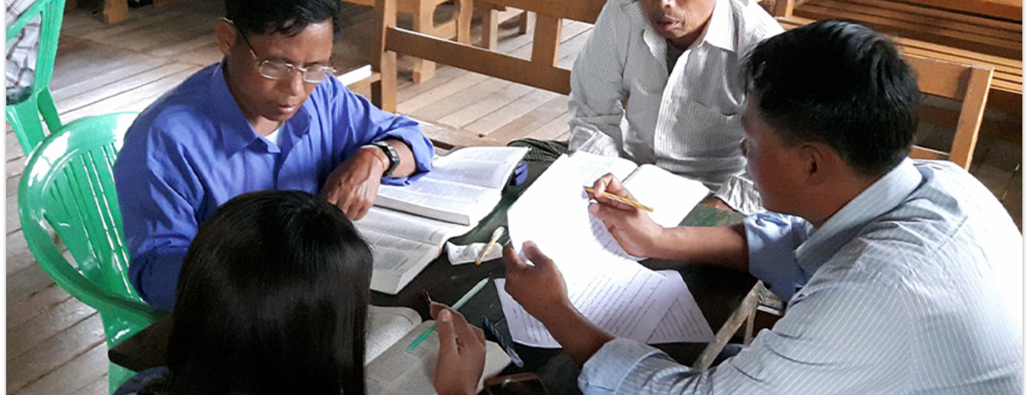
Translation Checking Steps
Two people work better than one; together they can earn a good wage for their labor. For if one falls, the other can lift up his friend. However, woe to the one who is alone when he falls if there is no one to lift him up (Eccl. 4:9-10).
All Scripture taken from the English Unlocked Literal Bible (ULB), ©2017, 2022 Wycliffe Associates, Available at https://bibleineverylanguage.org/translations, licensed under the Creative Commons Attribution-ShareAlike 4.0 International License.
The English ULB is based on the unfoldingWord® Literal Text, CC BY-SA 4.0. The original work of the unfoldingWord® Literal Text is available at https://unfoldingword.bible/ult/.
COBT 8-Step Translation

Slide 2
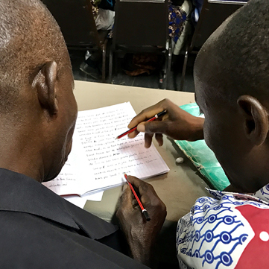

The 8-Step Translation Process
Drafting Steps
Checking Steps
Consume
Verbalize
Chunk
Blind Draft
Self-edit
Peer-edit
Key Word Check
Verse-by-Verse Check

Slide 3
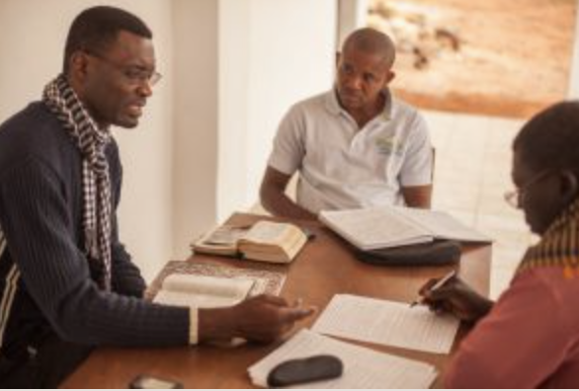
Checking Steps Defined
5
6
7
8
Peer-Check
Key Word Check
Verse-by-Verse Check
Self-Check
Compare each chunk to source; make any edits
Another translator compares and suggests edits
Work with a partner to ensure that the key words are all there and clear
Translator reads each verse of translation aloud
Checker 1, out loud, translates each verse back into the source language
Checker 2 listens and looks at source text to compare

Slide 4
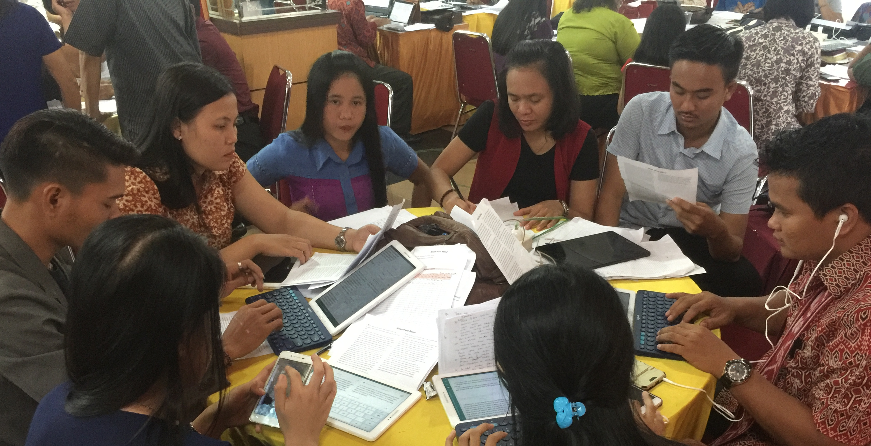
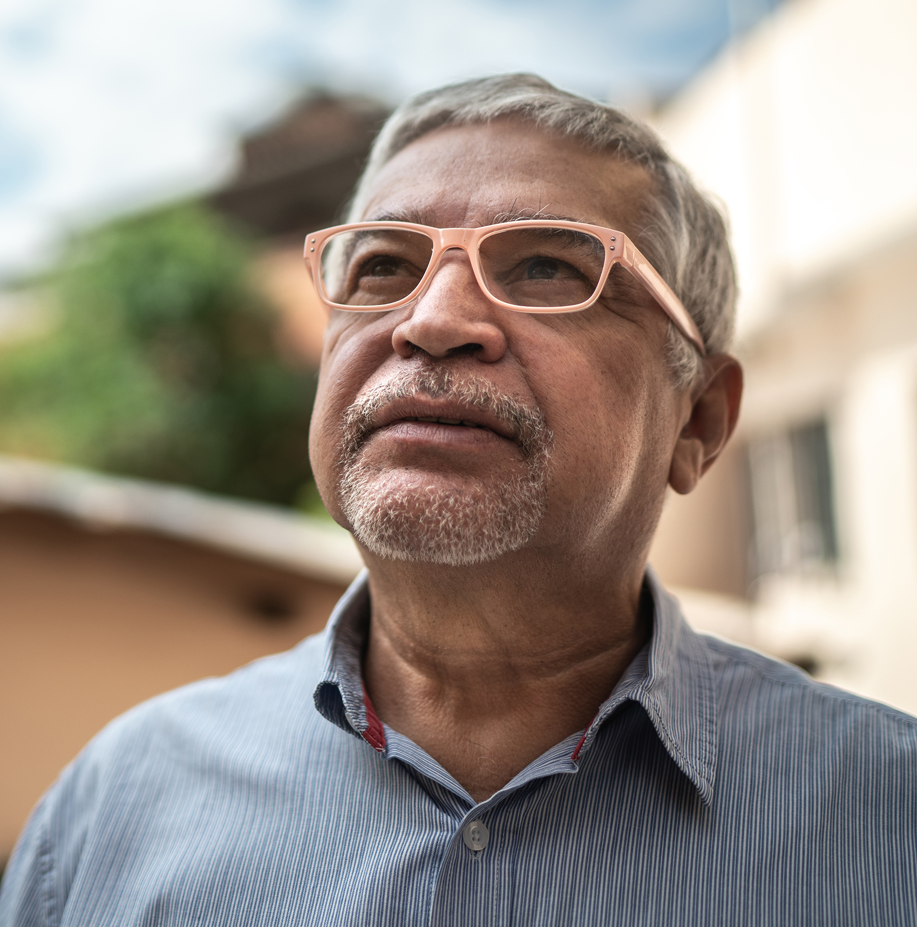
The checking steps have no time limit …
a great time for discussion and research to improve the text
Make changes as needed.
Pray for God’s guidance.

Slide 5
Try it
Check the work translated in last session
Did the checking steps improve the text?
Were there many errors?

Slide 6
?
What happens if you skip steps?

Slide 7

Checking Step 7:
Key Words

Slide 8
?
How would you define a key word?

Slide 9
A strong impact on meaning
Abstract words
Spiritual
terms
Often repeated for emphasis

Slide 10
?
What earlier translation steps might reveal errors?

Slide 11
?
What earlier translation steps might reveal errors?
Why target these words in a separate check?
Often no precise equivalent
Often hard to translate

Slide 12
For God so loved the world, that he gave his only Son, that whoever believes in him will not perish but have eternal life.
John 3:16 (ULB)

Slide 13
For God so loved the world, that he gave his only Son, that whoever believes in him will not perish but have eternal life.
John 3:16 (ULB)

Slide 14
Try it
Luke 17

Slide 15
Discuss
?
Are the lists the same?
Are some words on everyone’s lists?
Why the differences?

Slide 16
What to do with the key word list
Check translation for each key word.
Discuss difficult words and choose how to translate.
Create list to be used by all translators.

